Slide 1



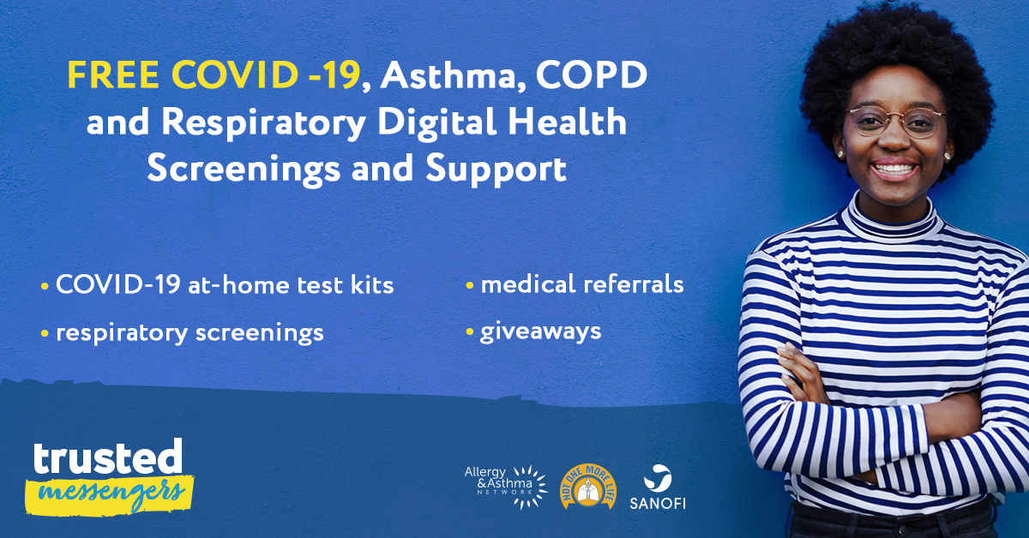
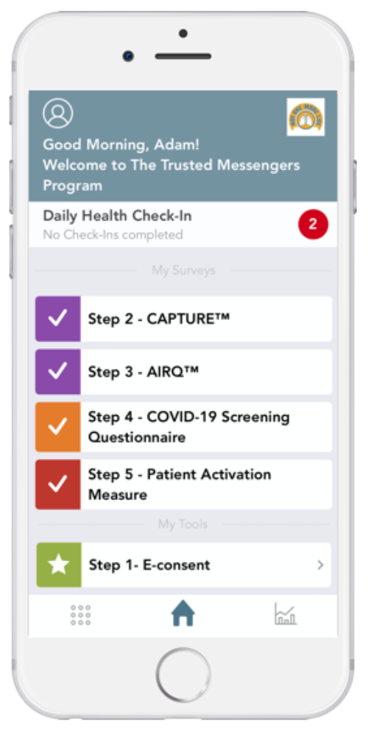
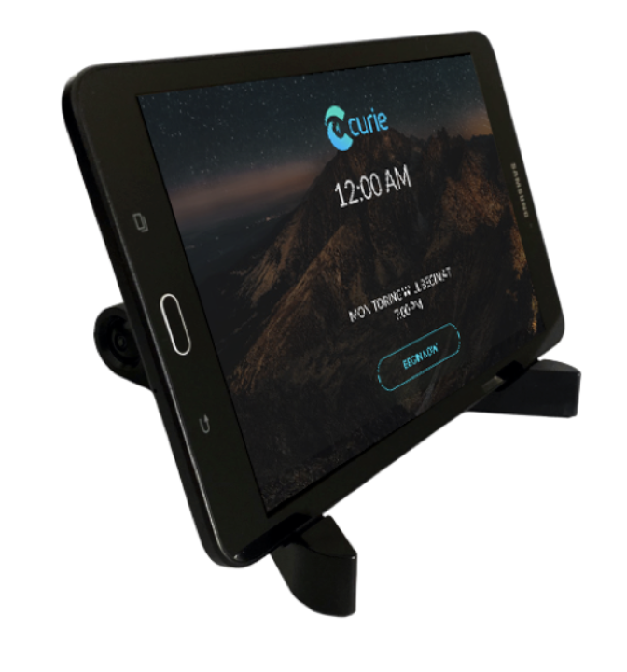
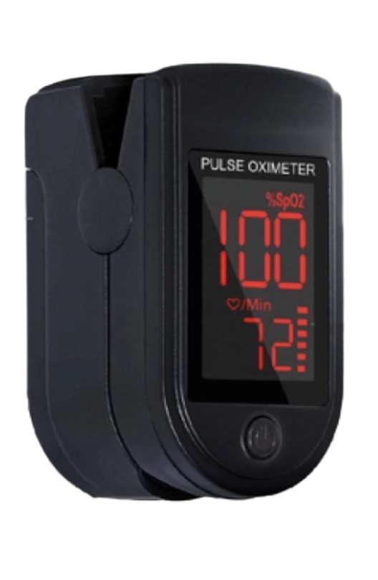
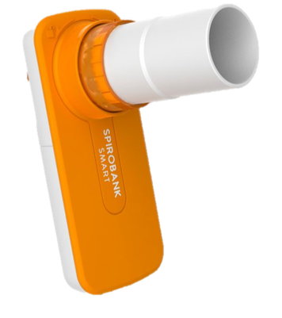

A Digitally Enabled Care & Real-World Evidence (RWE) Research Program Among Individuals with Asthma and COPD During the COVID-19 Pandemic
BACKGROUND
OBJECTIVES
METHODOLOGY
Minority populations bear a disproportionate burden of the morbidity, mortality and prevalence of respiratory illness, including asthma, COPD and COVID-19. This disproportionate burden is often a consequence of limited access to traditional healthcare resources¹. mHealth applications can take a multi-dimensional approach to optimizing healthcare delivery by empowering patients to be active in shared decision-making and promoting a high-touch environment to engage with healthcare providers and allies. mHealth applications have the potential to provide patients with health, self-management, and educational interventions to increase their quality of life. Moreover, The usage of mHealth applications within the care delivery workflow facilitates the collection of high-velocity and high-volume data — leading to secondary opportunities to support RWE initiatives.
The objectives of the Not One More Life, Trusted Messengers program were to:
Address health inequalities among racial and ethnic minority populations, specifically related to respiratory disease.
Improve long term health outcomes among participants with respiratory conditions (asthma and COPD).
Evaluate the impact of a digitally enabled program on respiratory outcomes.
Determine best practices for a national program to address racial and ethnic inequalities in access to respiratory care in the context of a global pandemic.
Screening events were conducted with community churches and targeted digital marketing to reach underserved communities. Eligible participants were enrolled in a 16-week remote monitoring program using the Health StorylinesTM platform to receive virtual coaching sessions, and report data through direct entry and synced devices.
The impact of the intervention on asthma outcomes and patient satisfaction was measured using changes in symptom severity from baseline, bi-weekly questionnaires, spirometry, peak flow, pulse oximetry, breath biomarkers, use of digital inhalers and digital engagement analytics.
RESULTS
In the initial phase of the program, Live and Digital screening events were conducted in collaboration with community churches and through targeted Facebook Ads to reach underserved communities (figure 1). Recruitment strategies were specifically designed to be culturally and linguistically appropriate for the target audience. Attendees were provided with a range of support including health assessments, food vouchers, school supplies for children and more.
Over 1,200 patients participated in the screening events. There were 277 eligible patients based on responses to AIR-Q and CAPTURE questionnaires assessing disease impairment and risk.
73 participants enrolled in the free 16-week coaching program, from an eligible group of 156 patients. The program involved weekly interaction between patients and coaches through the Health Storylines platform for real-time monitoring using the app and external devices (figure 2), customized Asthma, COPD and COVID-19 education tools co-created with the Allergy & Asthma Network, and the completion of research instruments including ePRO instruments, patient and coach satisfaction questionnaires.
Directionally, the level of engagement and experience among participants was higher than the average Health StorylinesTM
users during the same period which can likely be attributed to the personalization of messaging and interaction with coaches.
Participants demonstrated the following improved outcomes over the course of the program:
Improved quality of life
Improved lung function
Reduced frequency of rescue inhaler use
Reduction in fatigue and tiredness
High participant satisfaction
In addition to the free text describing their perceptions and satisfaction regarding the intervention, participants also reflected on the impact of the COVID-19 pandemic on health-related quality of life and access to care, offering insights into the intersection of the pandemic experience among individuals with underlying respiratory conditions that placed them at increased risk of severe outcomes (example in figure 3).
This opportunity for patients to share the aspects of their health experience that matter to them represents a valuable form of Real-World Evidence that does not rely on pre-meditation or anticipation of domains of interest on the part of the researcher.
Figure 1: Example digital marketing banner to recruit patients to participate in the program.
CONCLUSIONS
The findings suggest that a combination of virtual coaching and digital disease management can play a needed role in the future of asthma management and research to improve symptom control, medication adherence, and patient satisfaction.
From the perspective of RWE, the datasets generated through programs such as this offer unique opportunities to capture novel insights into the domains that matter to patients for the purpose of defining value, identifying unmet needs, designing prospective research, developing behavior interventions and patient support programs.
Based on the success of the pilot program, this intervention is being implemented nationally, offering enhanced ability to collect data from racial and ethnic minorities and other underserved communities based on the digital nature of the program operations. Future research will assess differences attributable to SDOH and geography.
“Went on a 4-mile hike today with 833 ft elevation gain. I took my inhaler before going. I had breathing problems as soon as I hit steep inclines. Just paused and kept waiting to get breath back. Lots of wind and dust on the trail too, thankfully wearing a face mask helped that.“
Figure 2: Data collection tools
used in the program
Figure 3: Representative example reported by a patient in the My Journal tool
REFERENCES
AUTHORS & FOLLOW UP
Nelson LA, Zamora-Kapoor A. Challenges in conducting mHealth research with underserved populations: Lessons learned. J Telemed Telecare. 2016;22(7):436-440. doi:10.1177/1357633X15609853
Renee Willmon¹, Oluwafunmi George², Shameni Selvarajah³, Jared Adams⁴, Grace Soyao⁵, Mary Hart⁶, De De Gardner⁷, Tonya Winders⁸
Senior Director, Evidence and Outcomes, Self Care Catalysts, an Alira Health Company, Toronto Canada
Team Lead, Patient Acquisition and Engagement, Self Care Catalysts, an Alira Health Company, Toronto Canada
Associate Manager, Scientific Evidence, Self Care Catalysts, an Alira Health Company, Toronto Canada
Chief Science Officer, Self Care Catalysts, an Alira Health Company, San Francisco, USA
For more details, please reach out to Renee.willmon@alirahealth.com
President and Founder, Self Care Catalysts, an Alira Health Company, Toronto Canada
Research Director, Allergy & Asthma Network, Vienna VA, USA
Research Director, Allergy & Asthma Network, Vienna VA, USA
CEO & President, Allergy & Asthma Network, Vienna VA, USA

